Slide 1
Data Visualization Course

Slide 2
Before the Course
Upon completion of this course, you will have acquired general knowledge that can form the basis for entry-level data visualization and data analysis.
Since the specific topics are difficult to understand and it will not be easy for the person to settle the logic during the lesson, a lot of individual practice is required.
Slides will be explained with images rather than text. That is why it is extremely important to take notes during the lesson.
Since the titles are sufficient for basic level algorithms, the titles should be researched, and research should be done on sites that contain plenty of practice and theoretical information.

Slide 3



What Will You Learn In This Course
What is data, how does it affect our lives?
What are the requirements and additional capabilities for Data Visualization?
Python’da En Popüler Veri Görselleştirme Kütüphaneleri ve Teknikleri
Most Popular Types of Data Visualization
Simple and almost one-line practical examples for each visualization type
An end-to-end project that shows the process from reading data to PDF report!

Slide 4
Mert Çobanov
Github: cobanov
Linkedin: mertcobanoglu
Twitter: mertcobanov

Slide 5
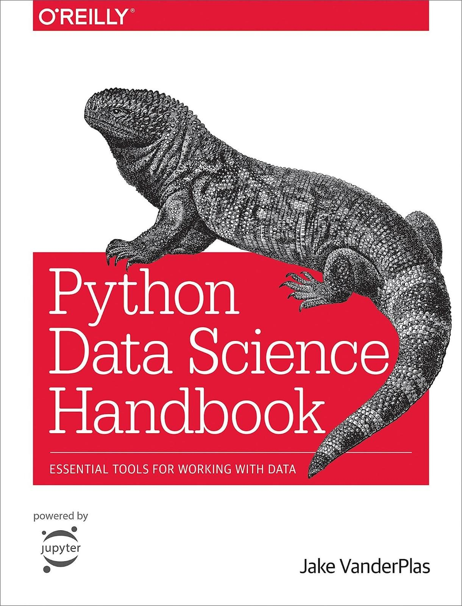


Kaynaklar
Python Data Science
Handbook
Jake VanderPlas
Hands-on Machine Learning with Scikit-Learn, Keras & TensorFlow
Aurelien Geron
Stanford University
stanford.edu/~shervine/
Shervine Amidi

Slide 6

Tukey
John Tukey is one of the biggest names in statistics and is also the inventor of Exploratory Data Analysis (EDA).
Tukey has contributed to various fields of engineering, mathematics, statistics and science. Most of these are recorded in the Collected Works, volumes of which began to be published in 1984.
Time Series (2 cilt??)
Philosophy and Principles of Data Analysis (2 cilt)
Graphics
More Mathematics
Factorial and ANOVA
Multiple Comparisons

Slide 7
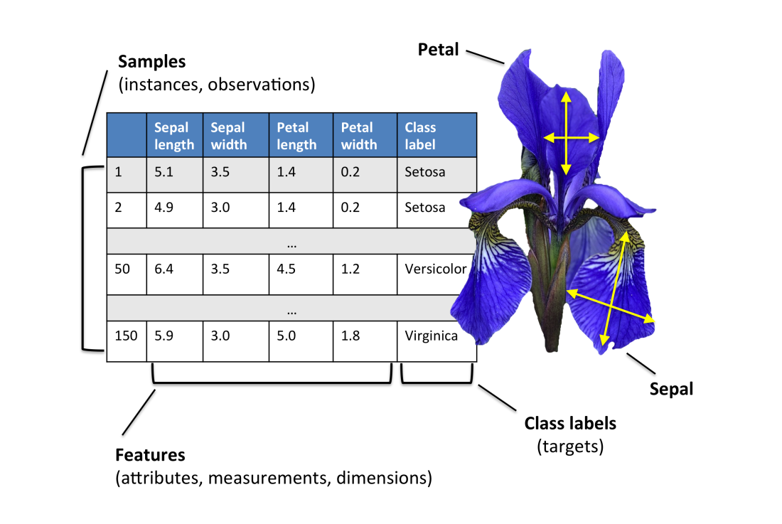
What is Data?
It is the gathering of information for easy analysis and recording with configuration.
One or more clusters of information.
It is usually obtained through research, observation, experiment, census, measurement.
Age, name, phone number, the result of a sum, or the average age of the class are data.

Slide 8
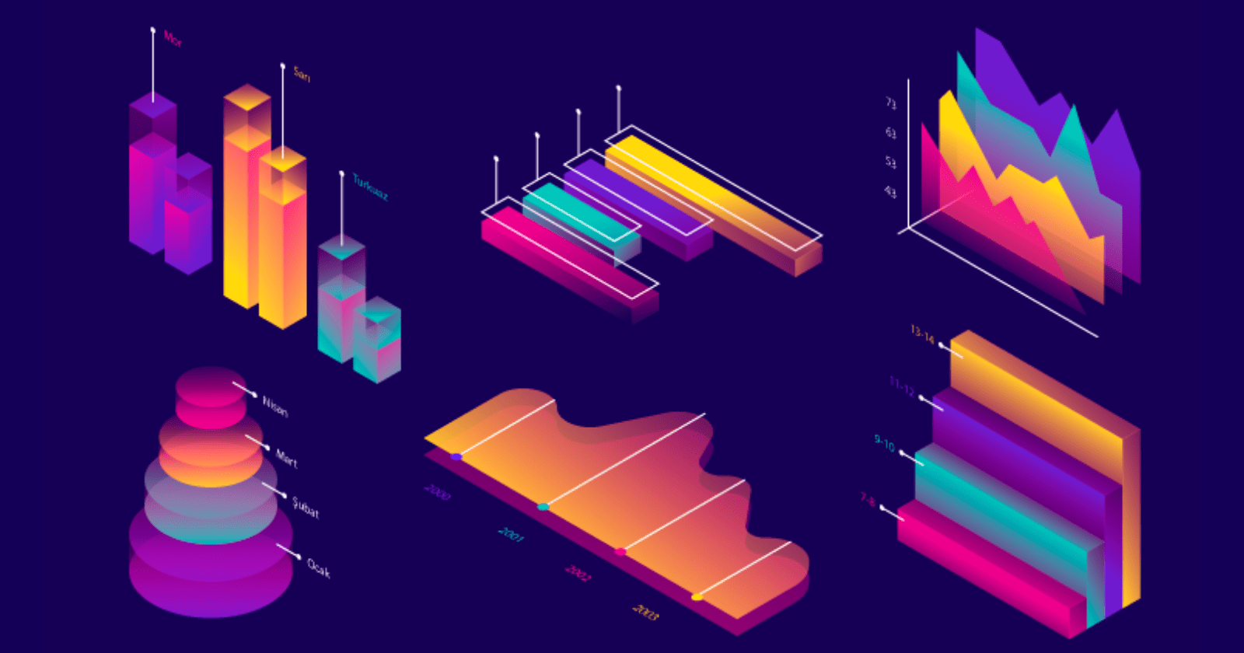
What is Data Visualization?
Data visualization is one of the key skills in applied statistics and machine learning that focuses on quantitative descriptions and predictions of data.
While exploring a dataset, it is intended to observe the following:
Patterns
Outliers
Trends
Distributions
Data visualization is used to express and simply show relationships.
You can quickly gain a qualitative understanding of most data you encounter.

Slide 9
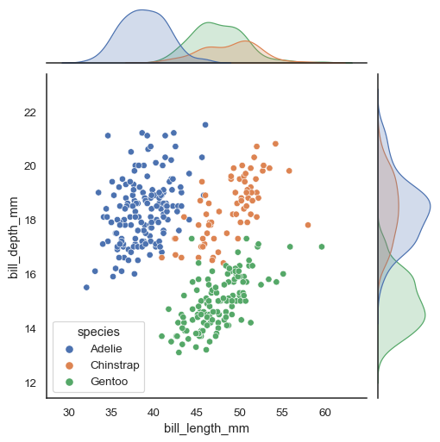
Advantages of Data Visualization
Better Analysis: Highly effective in examining overlooked elements, trends, and distributions in data tables.
Quick Action: Data visualizations allow rapid interpretation of data.
Identifying Patterns: Large amounts of complex data, when visualized, can facilitate insights and allow relationships between data to be found.
Finding Errors: Visualizing helps you quickly identify errors in data. If the data tends to contain false samples, it can be quickly identified by visualization.

Slide 10
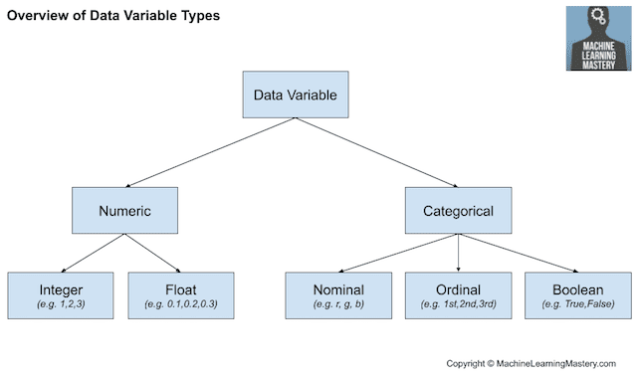
Data Types
Numerical Data Type:
Integer: whole-valued positive, negative number or 0 (without fraction)
Float: Floating point values
Categorical Data Type:
Nominal: Unordered tags
Ordinal: Ordered tags
Boolean: True and False values

Slide 11
Visualization
Types

Slide 12
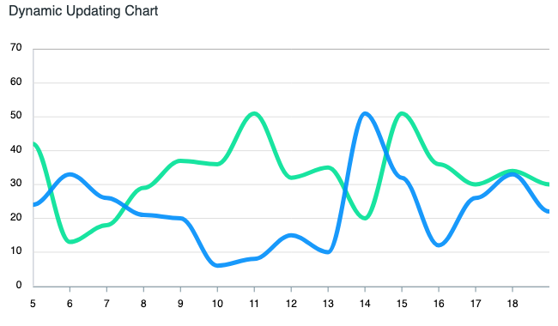
Line Plot
The line plot is mainly used to show the relationship between two sets of numerical values. Generally, it is appropriate to show an increasing or decreasing trend between two dependent variables.
For example, if you want to see how the weather has changed over a 24-hour period, you can use a line plot with hourly information on the x-axis and weather in degrees on the y-axis.
Makes it easy to scan information quickly to understand trends in data

Slide 13
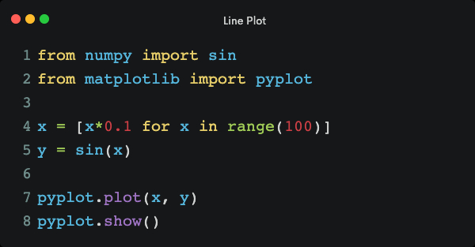
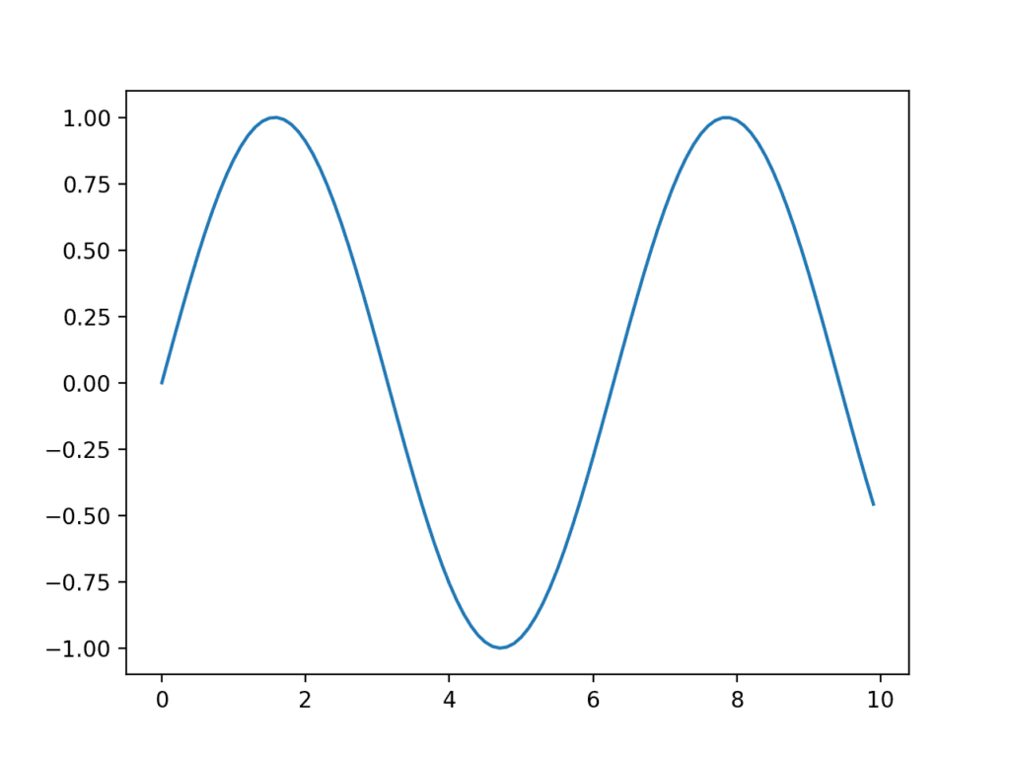
Line Plot Application
Line plots are useful for presenting time series data as well as any series data where there is a sequence between observations.
The following example creates an array of 100 floating point values as the x-axis as observations on the y-axis and a sine wave as a function of the x-axis. Results are plotted as a line plot.

Slide 14
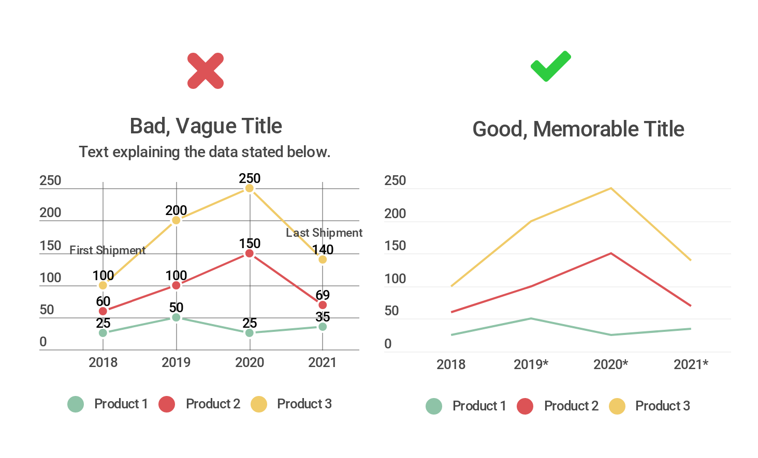
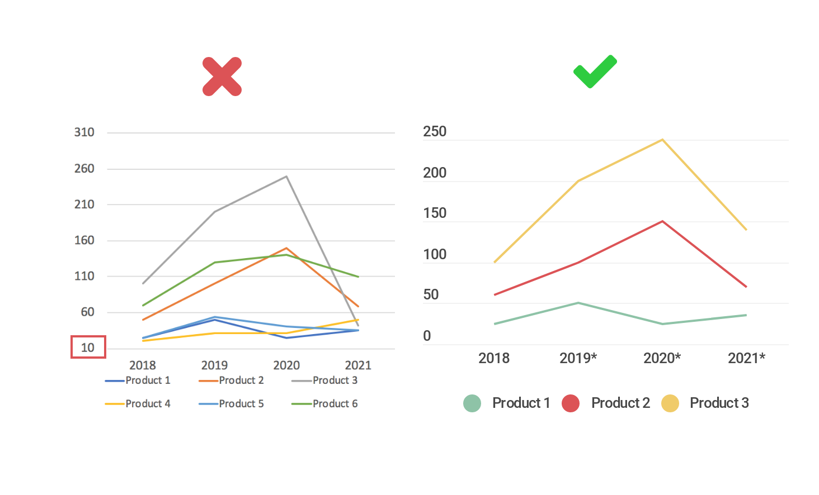
Incorrect Displays
Adding Unnecessary Text
Smooth and Clean Axes

Slide 15
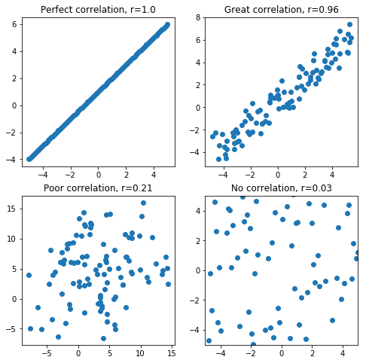
Scatter Plot
A Scatterplot is mainly used to plot the relationship between two numerical groups in the form of scattered points.
Each point on the graph is shown to represent a single observation:
The x-axis represents a feature of the sample
Y axis represents a different feature of the same sample
Scatter plots are useful for showing the relationship or correlation between two variables.

Slide 16
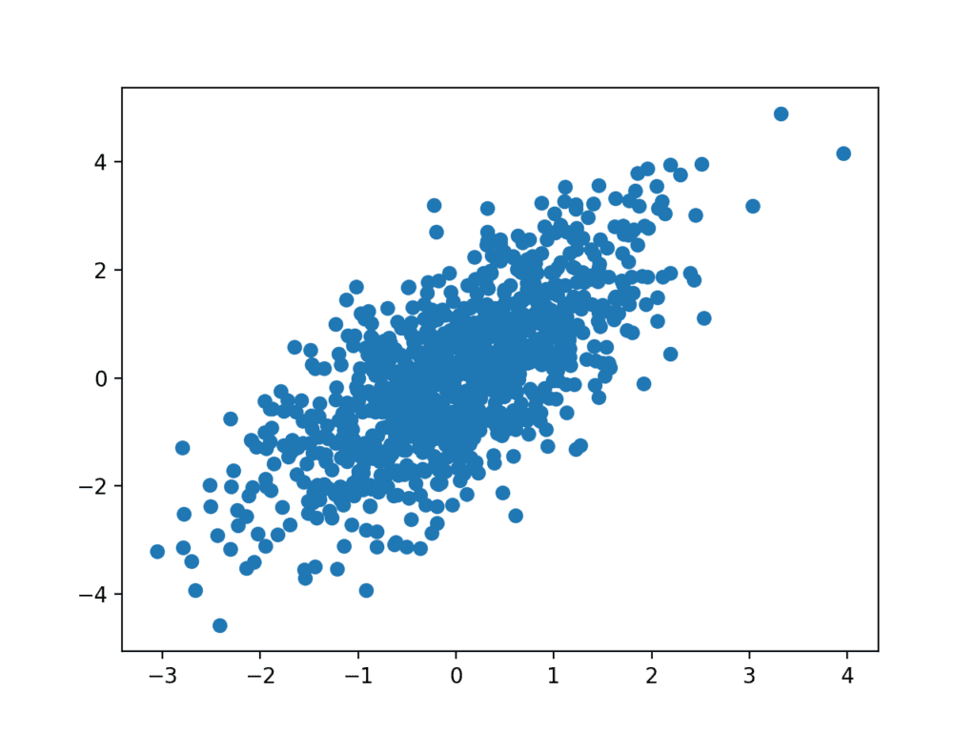
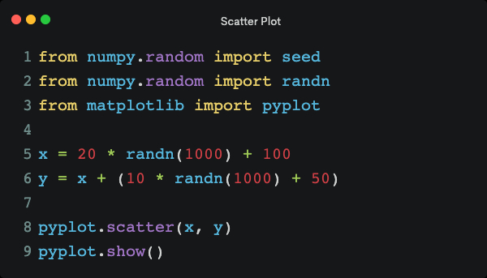
Scatter Plot Application
The following example creates two related data samples. The first is a sample of random numbers from a standard distribution. The second depends on the first by adding a second random value to the value of the first measure. The image on the left shows the correlation and distribution graph of these two variables.

Slide 17
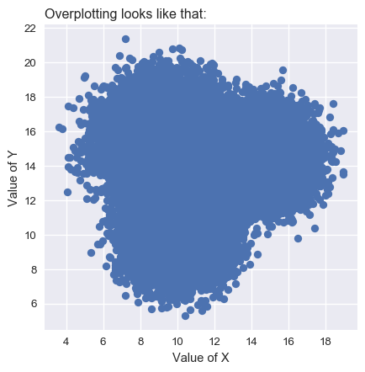
Scatter Plot Possible Errors
Overplotting is the most common error when the data size is high.

Slide 18
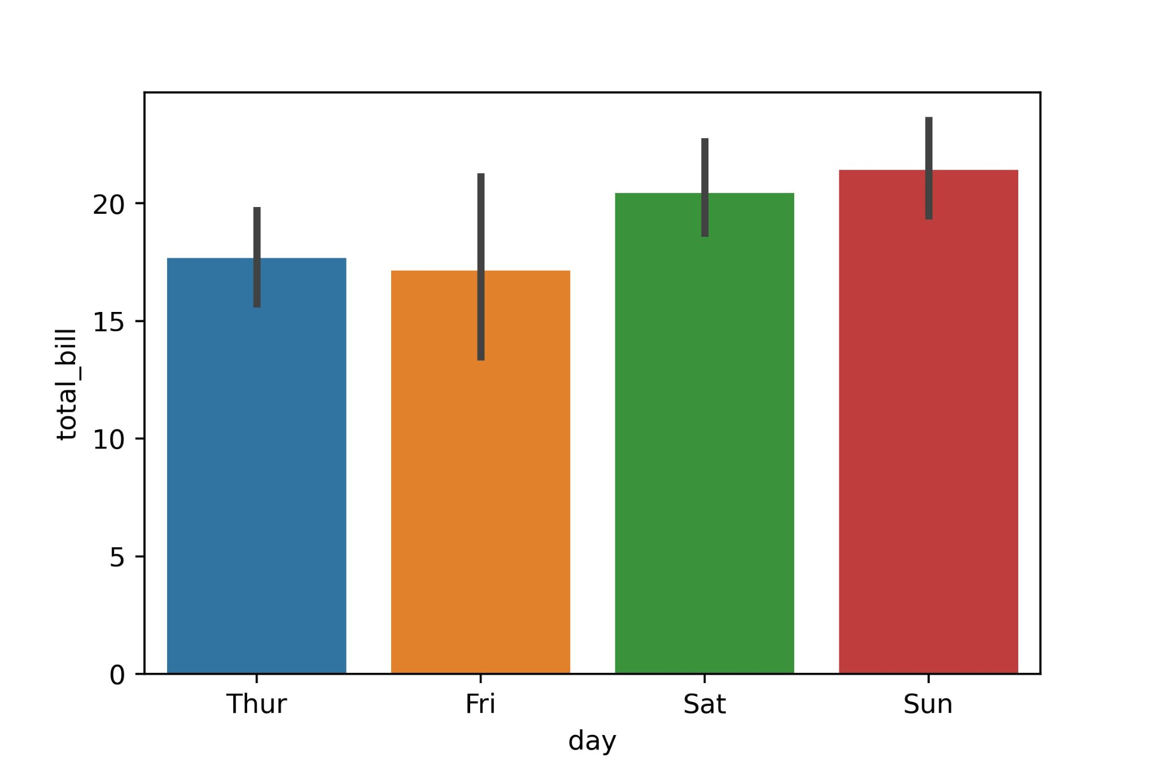
Bar Plot
The bar graph can display sum, mean, median, etc. It is used to plot the relationship between unique values in a grouped categorical column.
Categorical values are transmitted as the x-axis, and the corresponding aggregated numeric values are transmitted on the y-axis.
Used to compare data from different category
One axis of the chart shows the specific categories being compared and the other axis represents a measured value
The bar chart should not be confused with the histogram! Box Plots are used for categorical values, while histograms are used for continuous values.

Slide 19
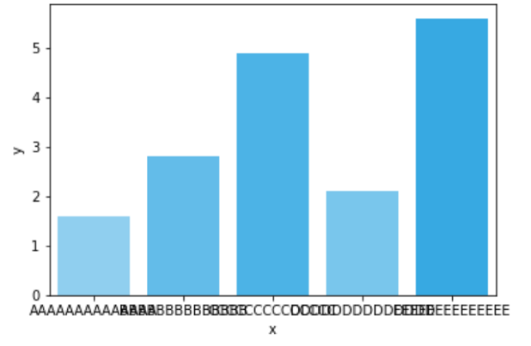
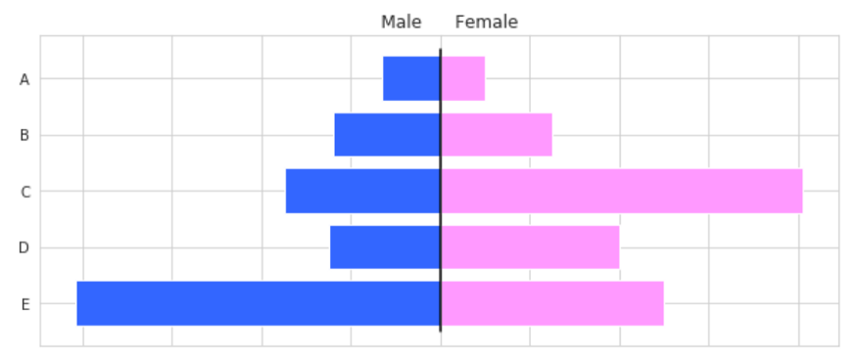
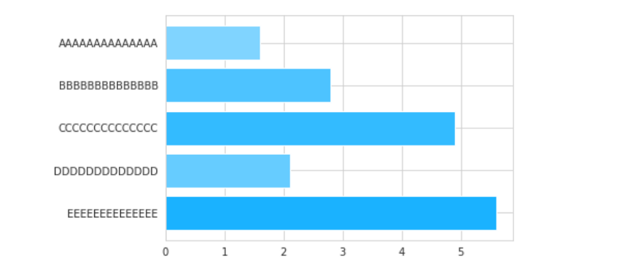
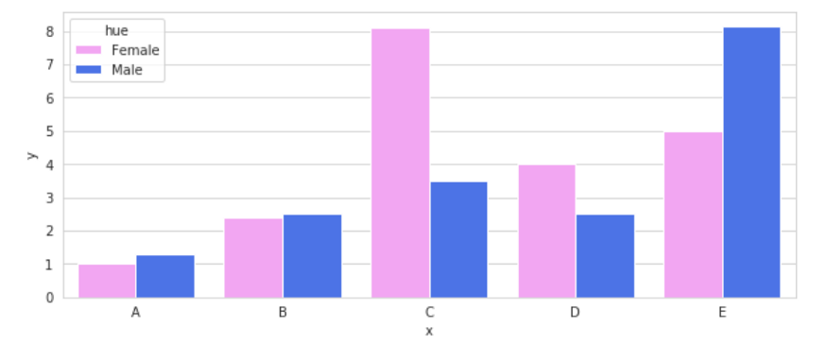
Bar Plot Possible Errors
Location of tags
Bidirectional graphics

Slide 20
Bar Plot Application
Code Example
tips = sns.load_dataset("tips")
tips.head()
tips.describe().T
sns.barplot(x="day",
y="total_bill",
data=tips)

Slide 21
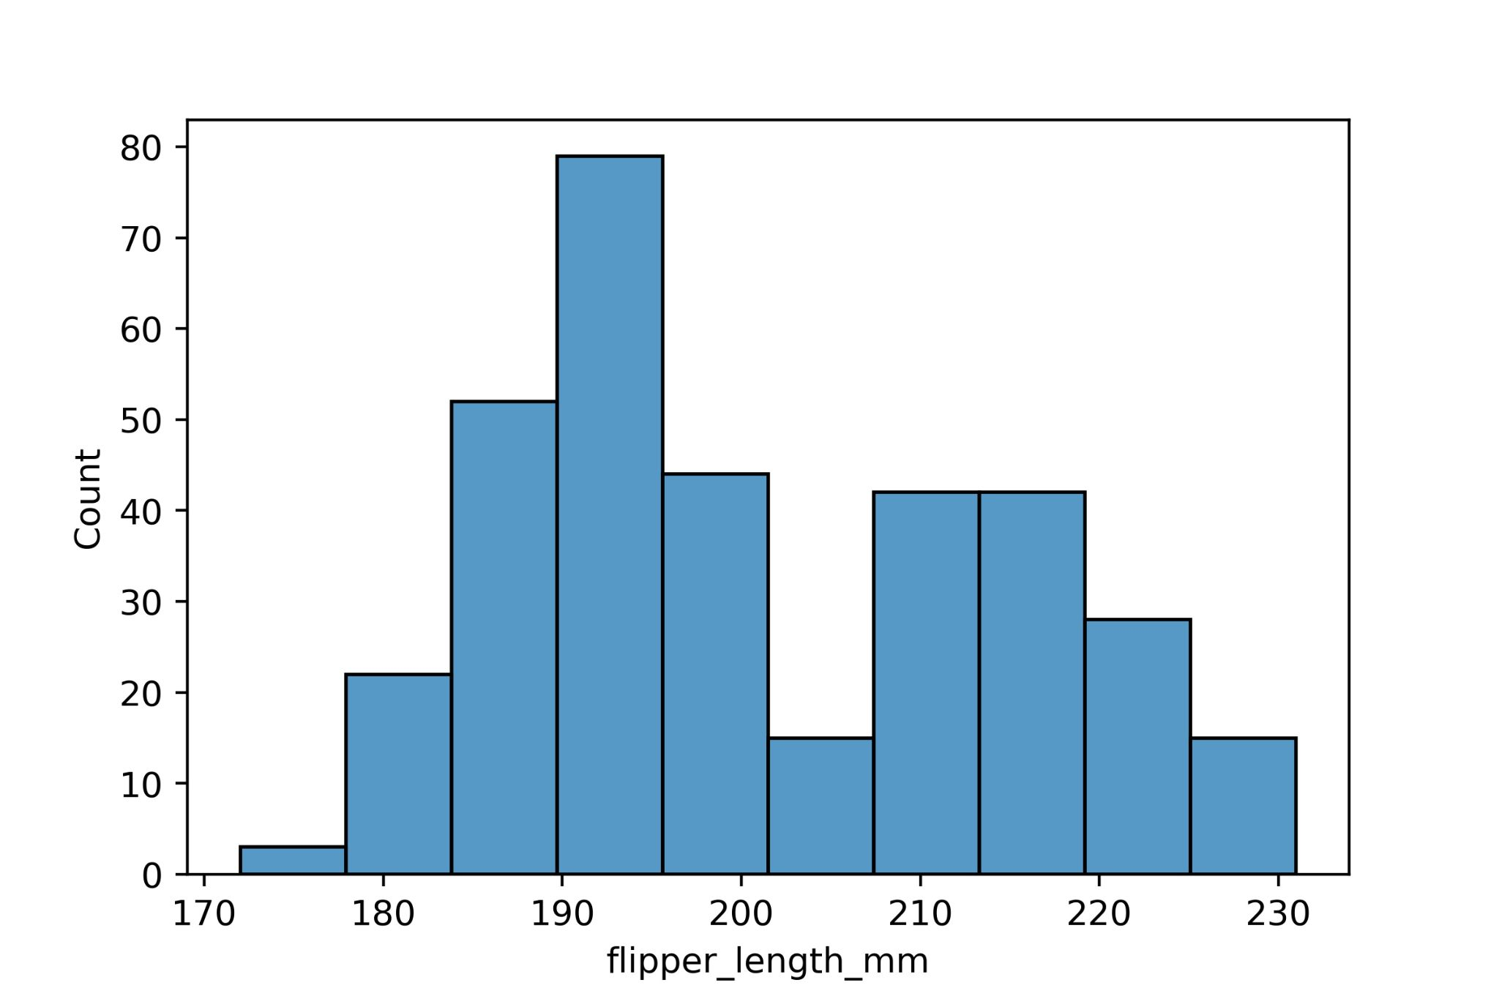
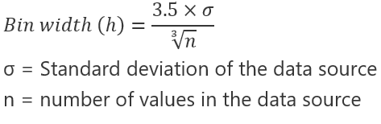
Histogram
Histograms are mainly used to display the data distribution for a numeric list of items.
It is a data visualization chart that shows the distribution of data over a continuous interval or a given time period.
The continuous variable shown on the x-axis is divided into discrete ranges, and the number of data you have in that discrete range determines the height of the bar
Histograms give an estimate of where the values are concentrated, what the extremes are, and whether there are any gaps or unusual values in the dataset.

Slide 22
Histogram Application
Kod Örneği
penguins = sns.load_dataset("penguins")
penguins.head()
penguins.describe().T
sns.histplot(data=penguins,
x="flipper_length_mm")

Slide 23
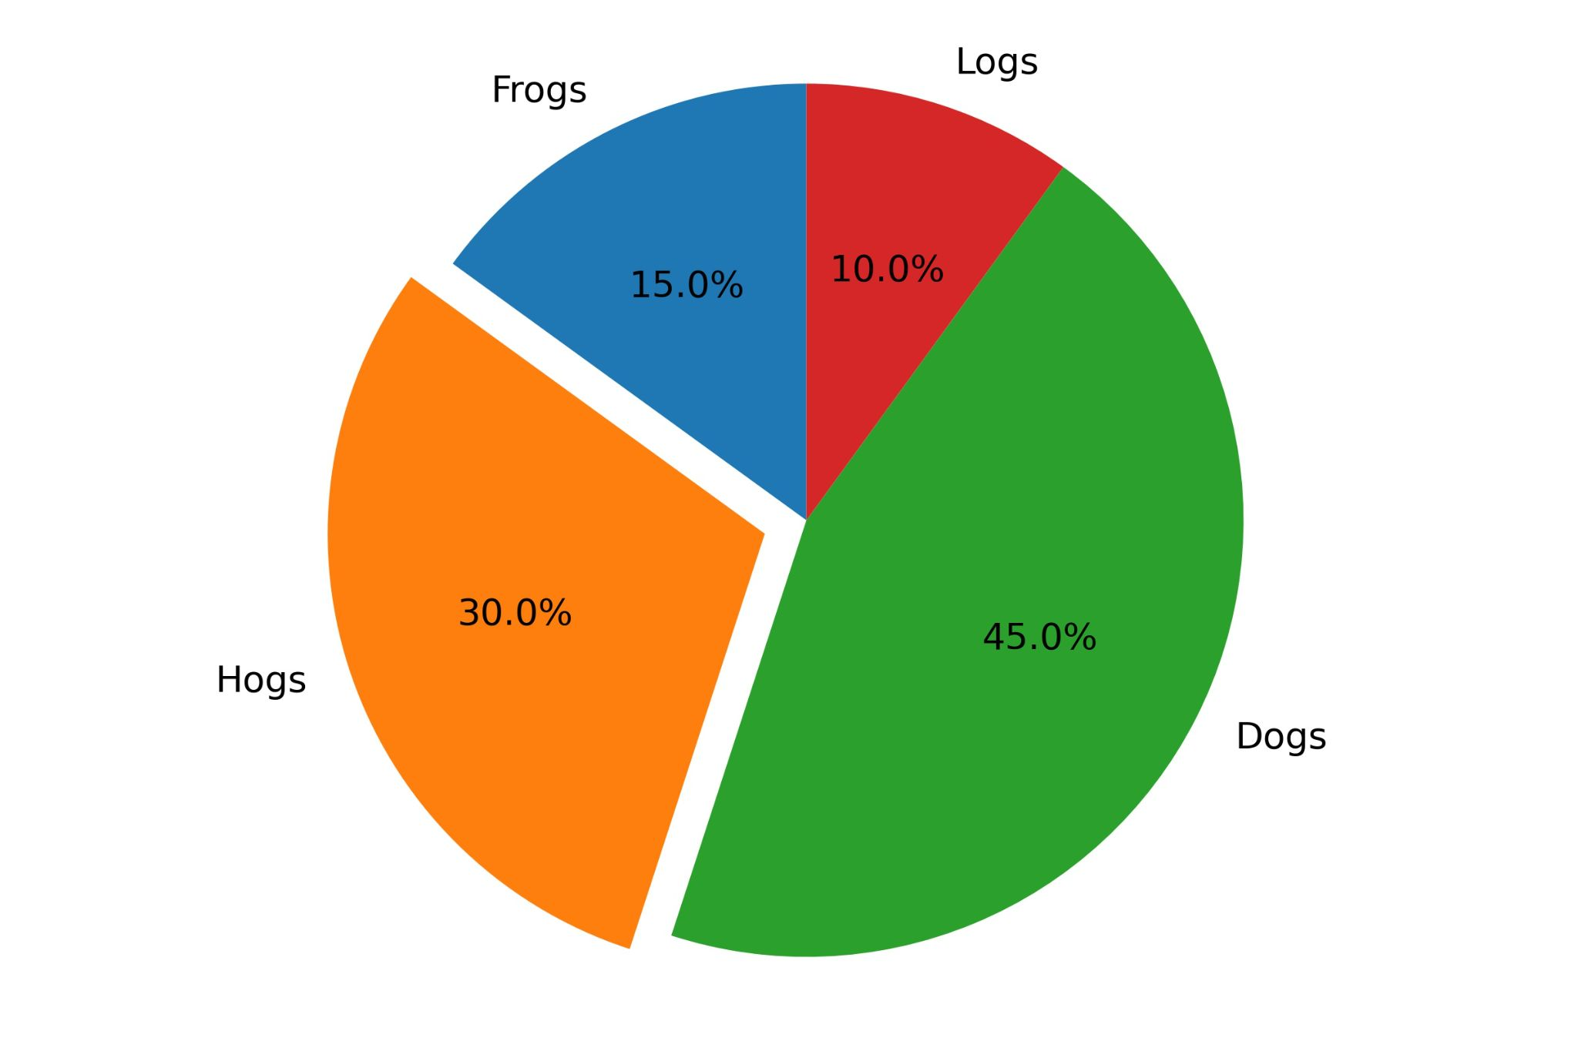
Pie Charts
Pie charts, as the name suggests, show the percentage distribution of values in a categorical column.
The relationship between parts of a whole can be seen clearly
Parts of the graph are proportional to the fraction of the whole in each category

Slide 24
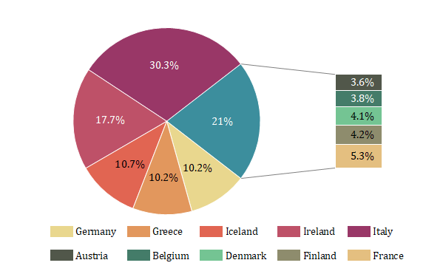
Pie Charts
Common mistakes
Several pie charts should not be compared
If the ratio is shown on the chart, the sum of the odds must be 100
Writing a description for each slice: Descriptions; should be brief and concise, in one or a few words

Slide 25
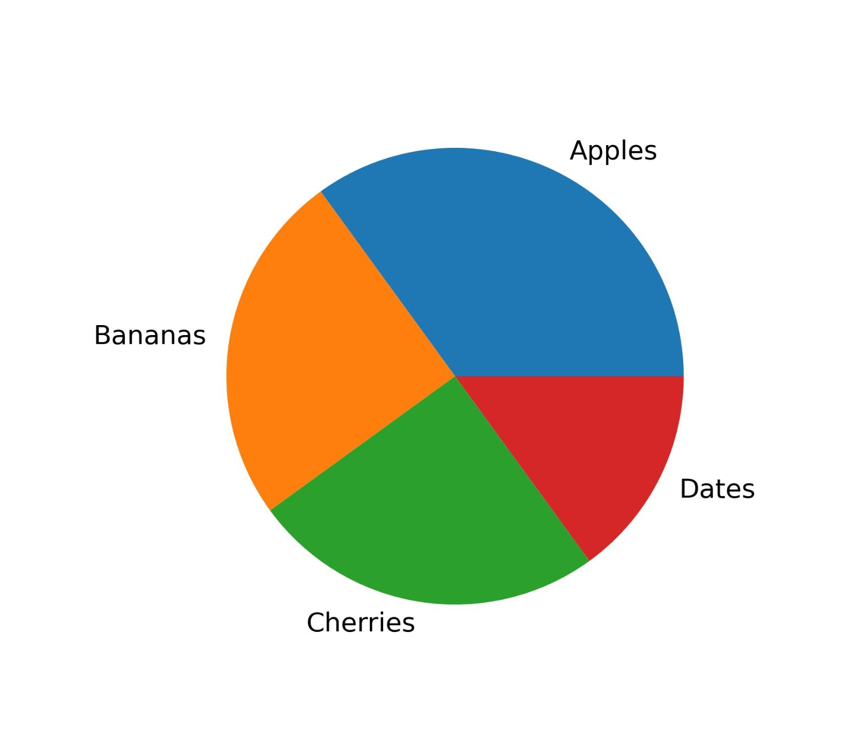
Pie Chart Application
Code Example
import matplotlib.pyplot as plt
import numpy as np
y = np.array([35, 25, 25, 15])
labels = ["Apples", "Bananas",
"Cherries", "Dates"]
plt.pie(y,labels=labels)
plt.show()

Slide 26
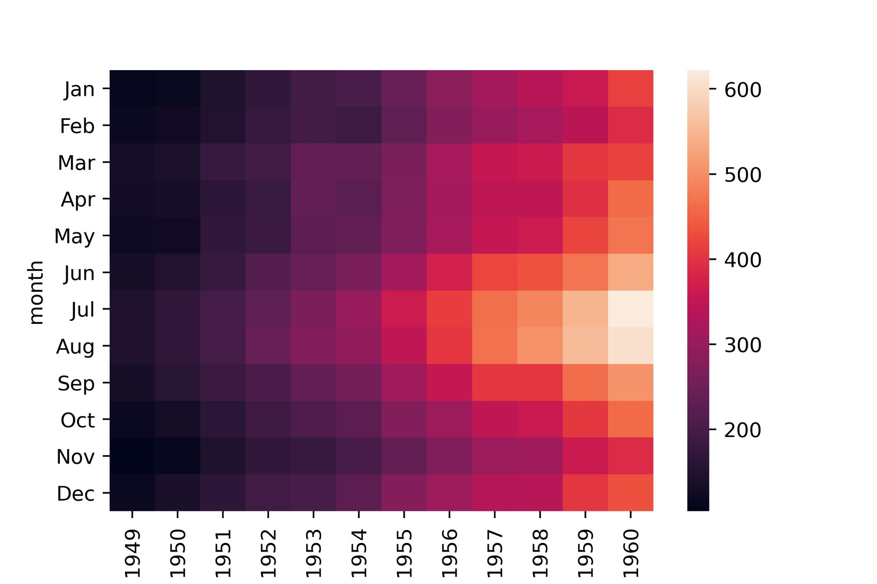
Heatmap
A graphical representation of data using colors to visualize the value of the matrix
Brighter colors are used to represent more common values or higher efficacy, and darker colors are preferred to represent less common or efficacy values.
It is often used in correlation maps or complexity matrices.

Slide 27
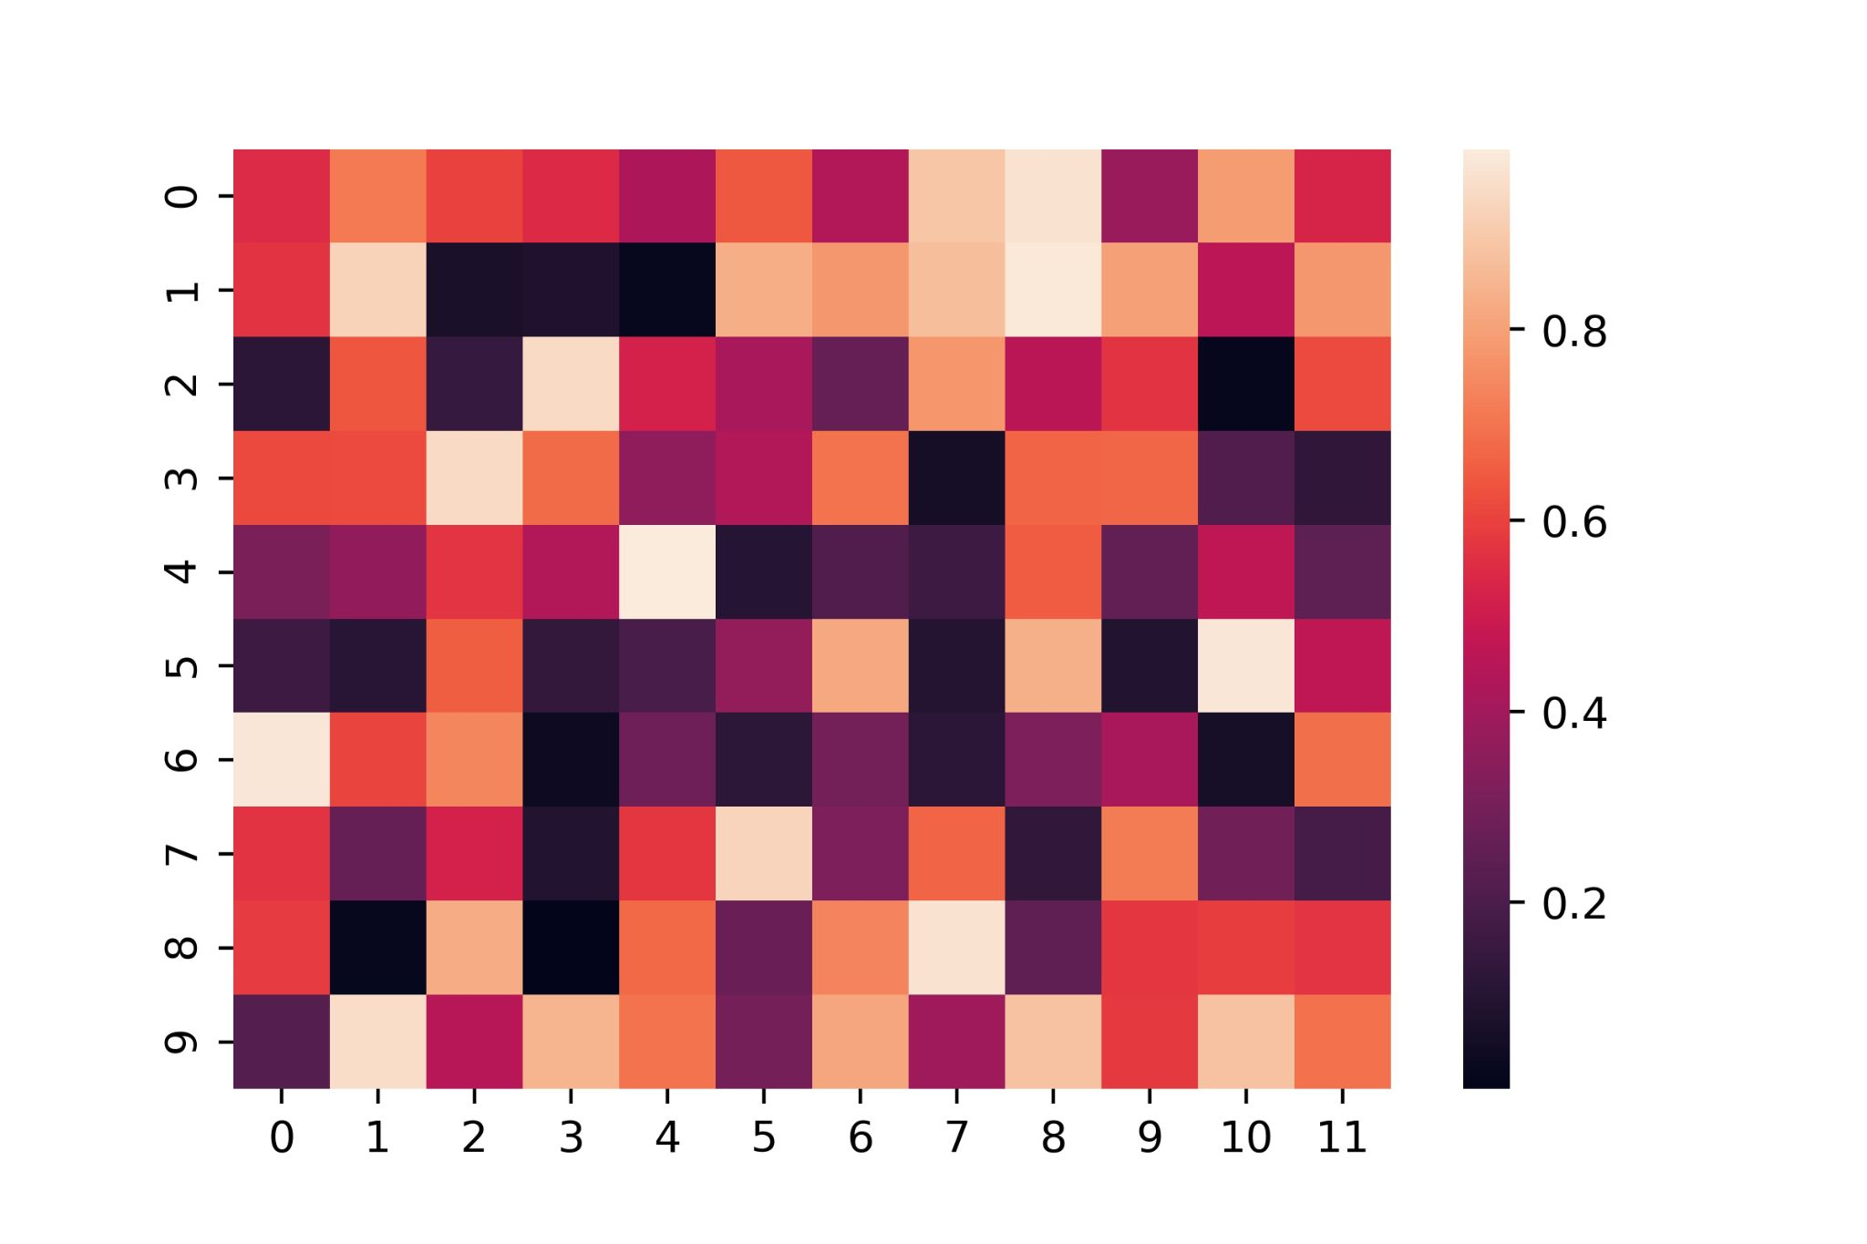
Heatmap Application
Code Example
import numpy as np
np.random.seed(0)
uniform_data = np.random.rand(10,12)
ax = sns.heatmap(uniform_data)

Slide 28
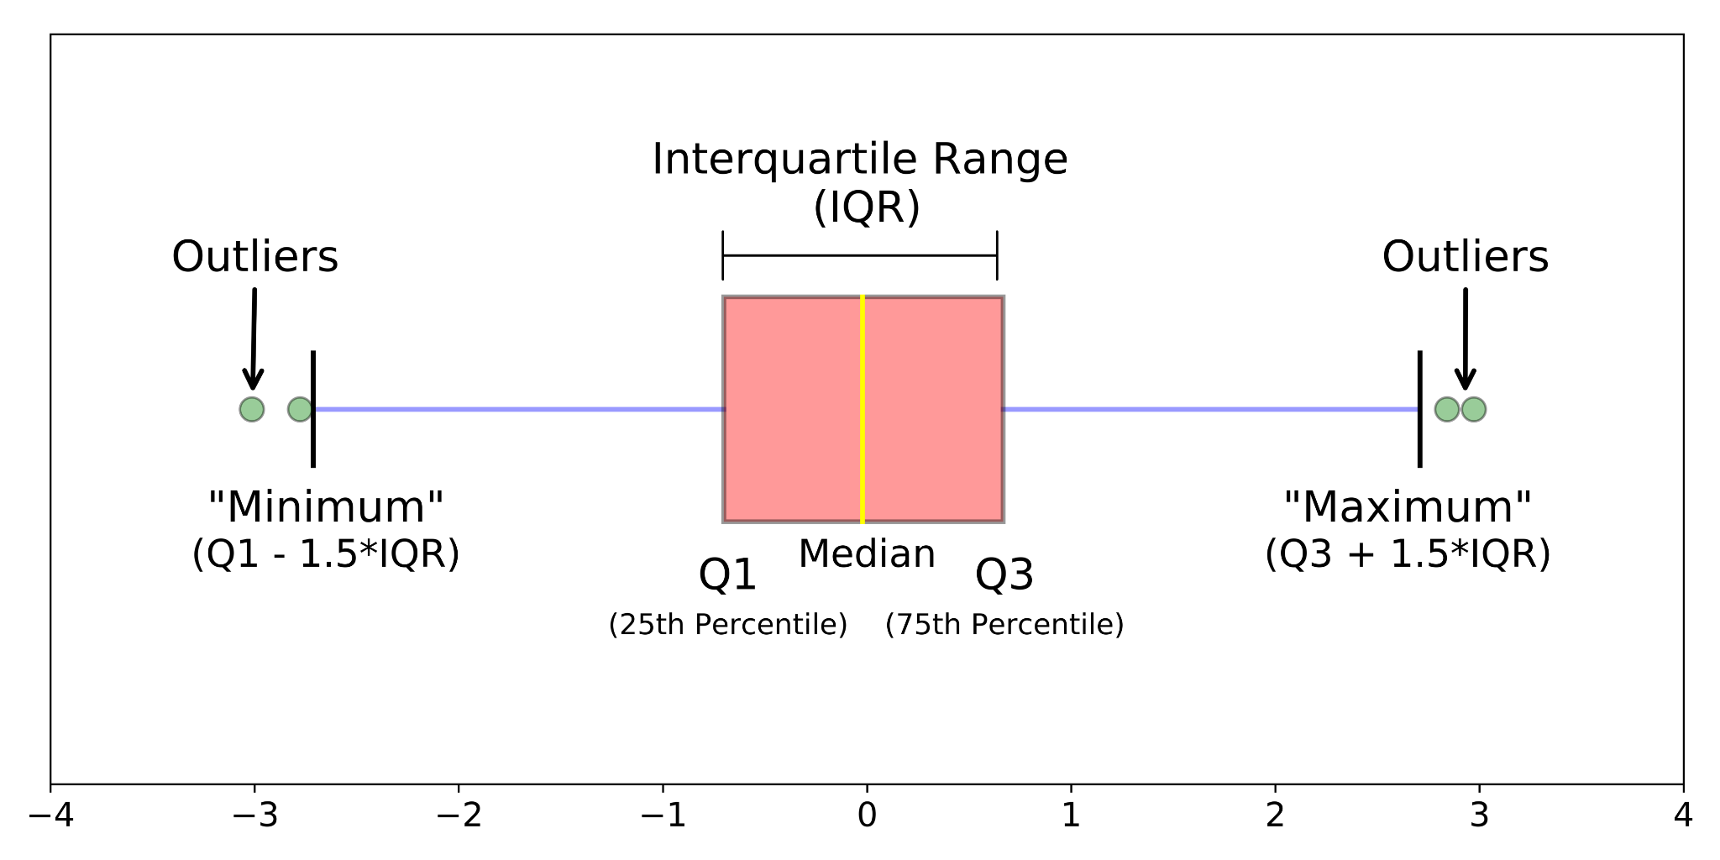

Box Plot
It is usually a visual representation of showing a data distribution among groups.
The simplest Box plot plots show the entire range of variation from minimum to maximum, the range of possible variation, and outliers.
Box plot consists of five parts
Minimum
First quarter
Median (second quartile)
Third quarter
Maximum

Slide 29
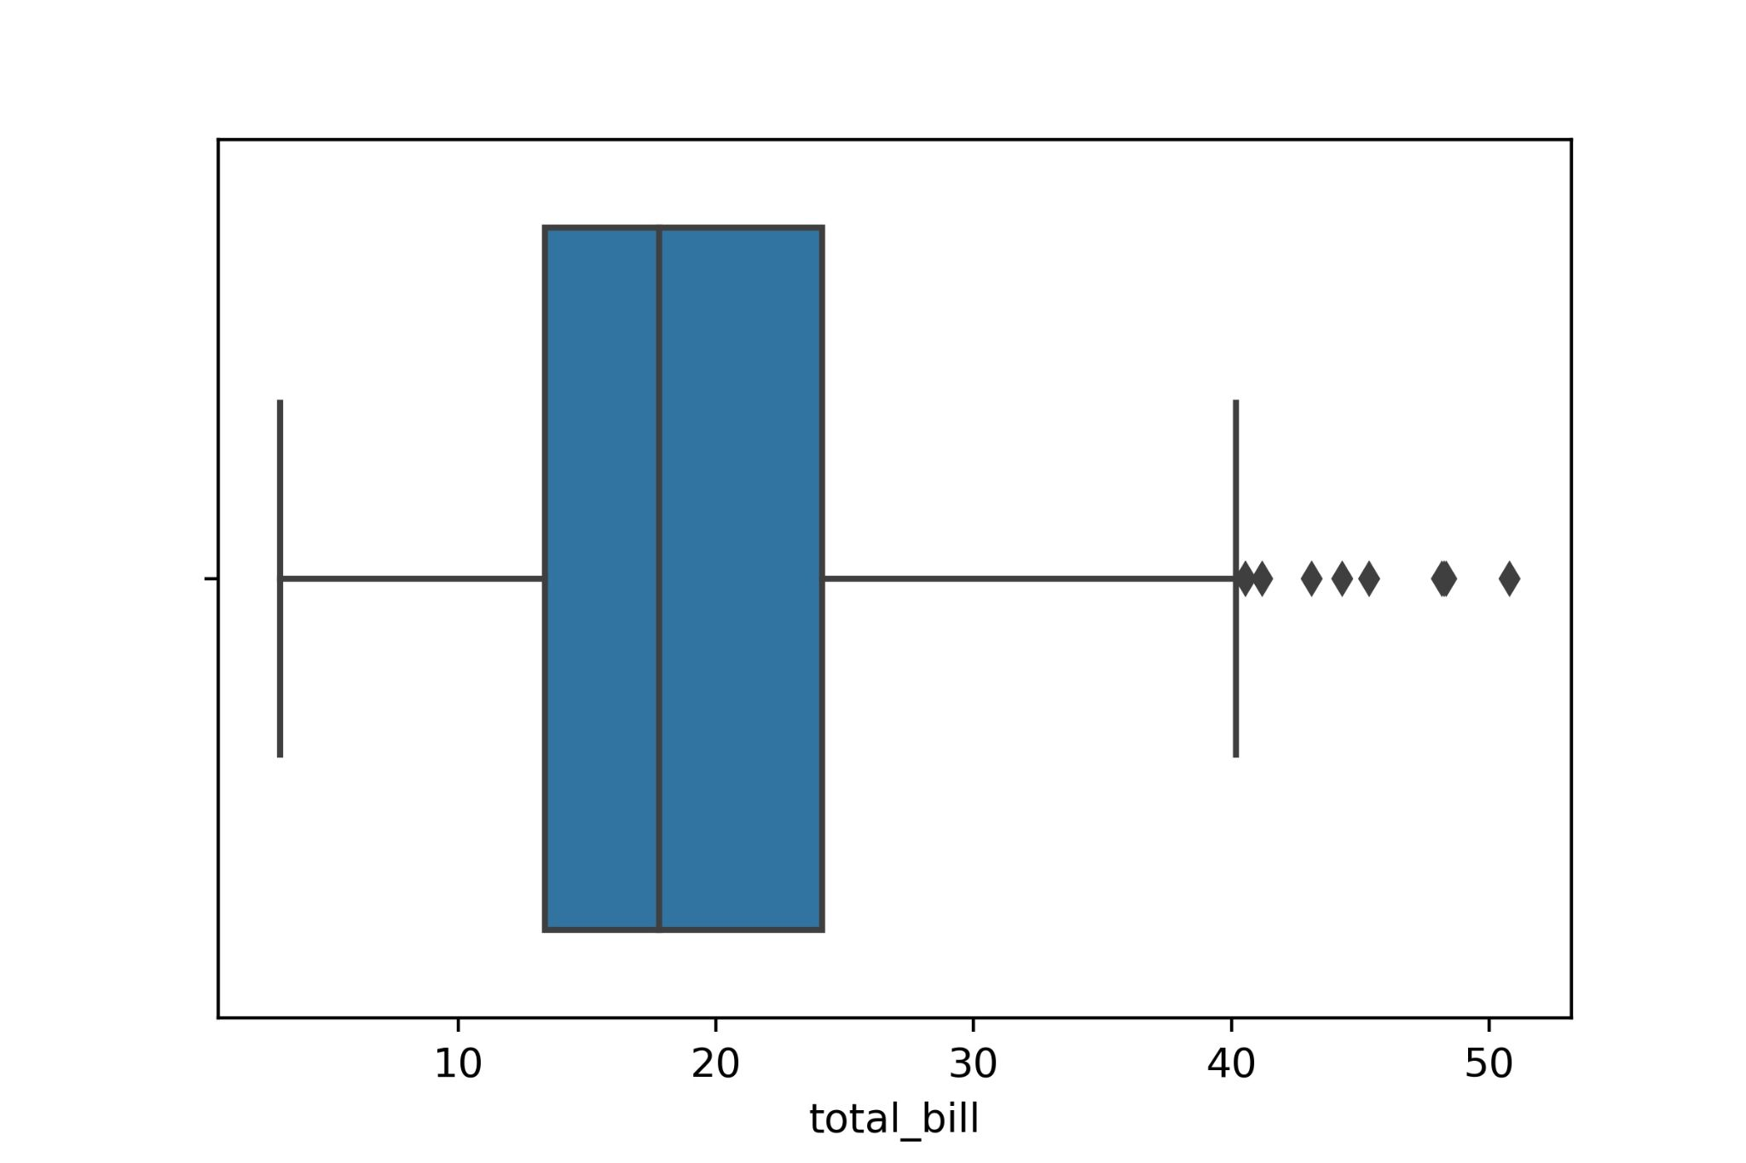
Box Plot Application
Code Example
tips = sns.load_dataset("tips")
tips.head()
tips.describe().T
sns.boxplot(x=tips["total_bill"])

Slide 30
End-to-End Applied Data Visualization Project

